Slide 1
AICS MAMANET ITALIA

Slide 2
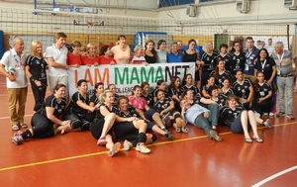
AICS MAMANET ITALIA
In Lignano for the WSG June 2015 the dream of Mamanet Italy was born.

Slide 3
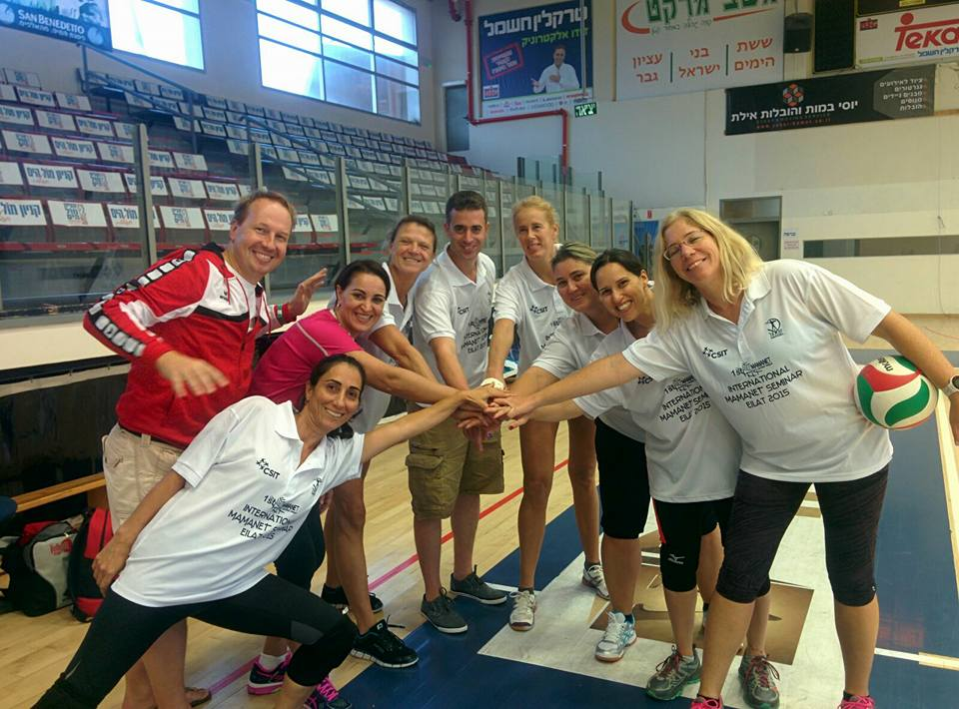
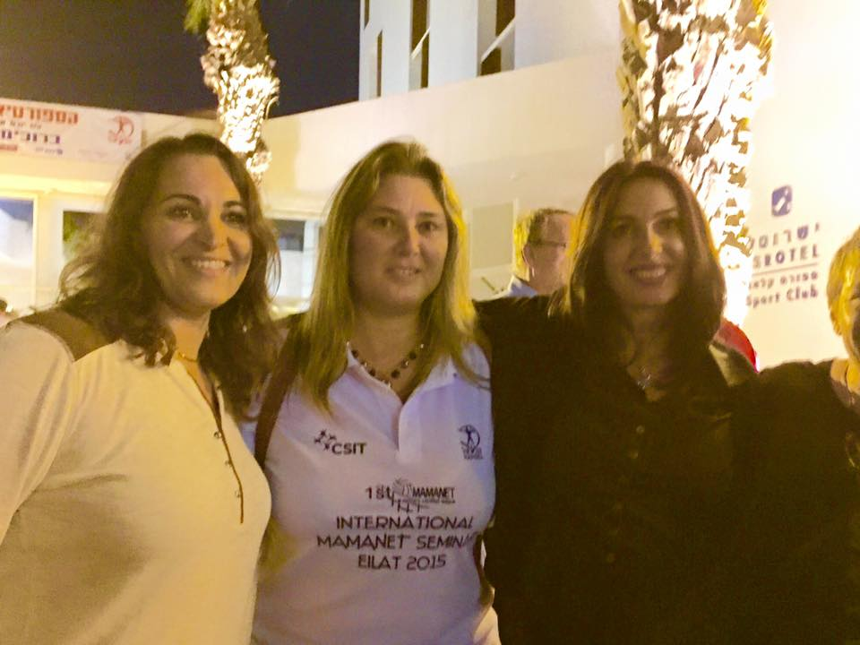
AICS MAMANET ITALIA
INTERNATIONAL MAMANET
SEMINAR EILAT 2015

Slide 4
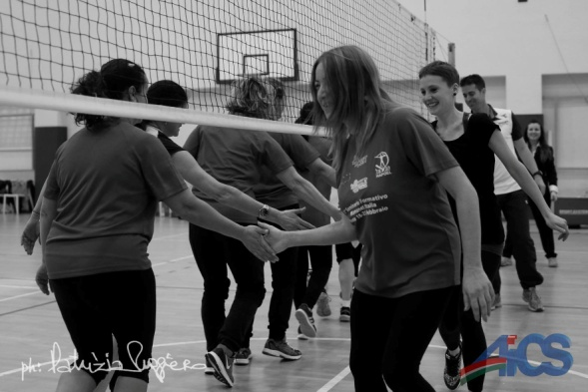
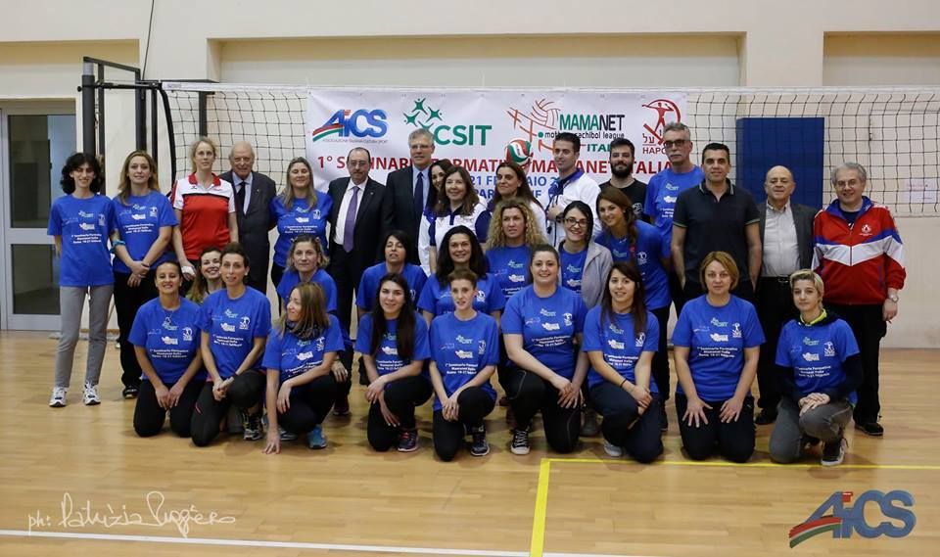
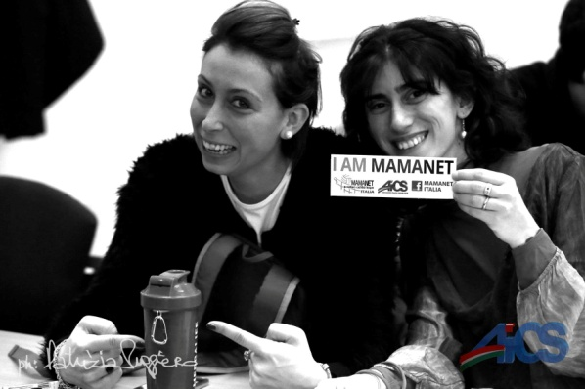
AICS MAMANET ITALIA
First big event was in February 2016 for organization of the first International Seminar AICS Mamanet Italy

Slide 5
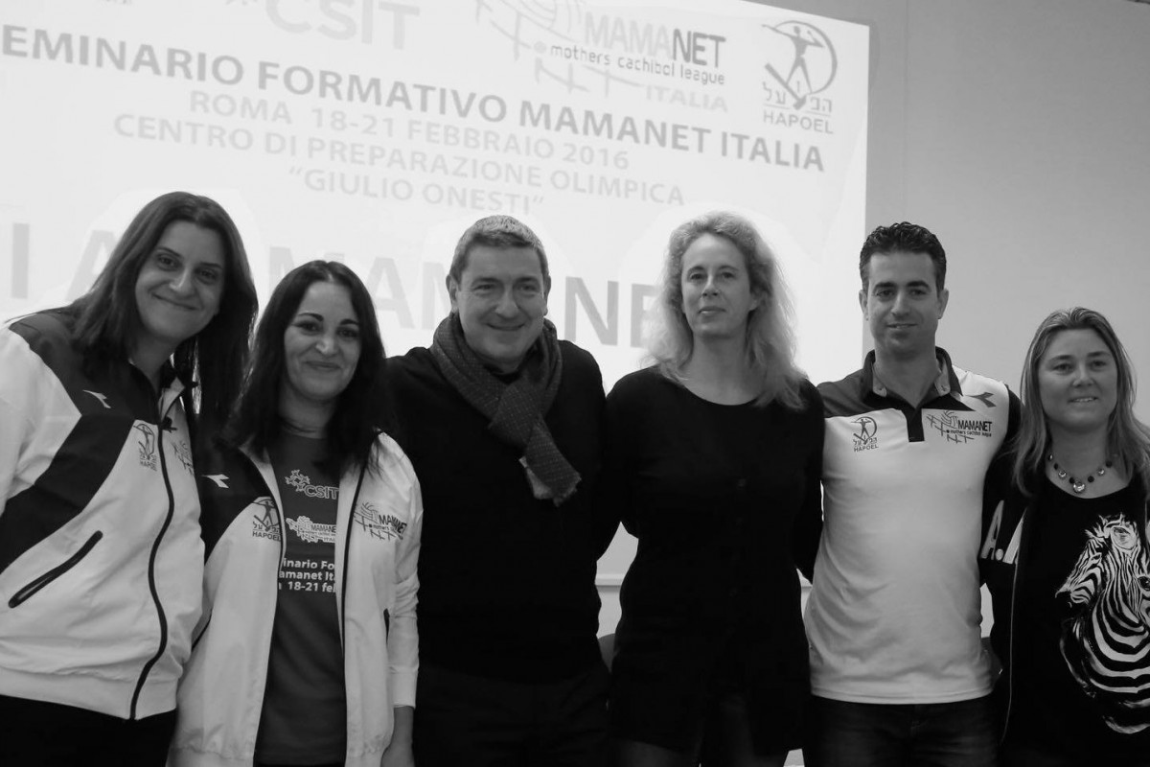
AICS MAMANET ITALIA
It was a big success, with more than 30 partecipants coming from ten different cities, including Austrian Mamanet delegation.

Slide 6
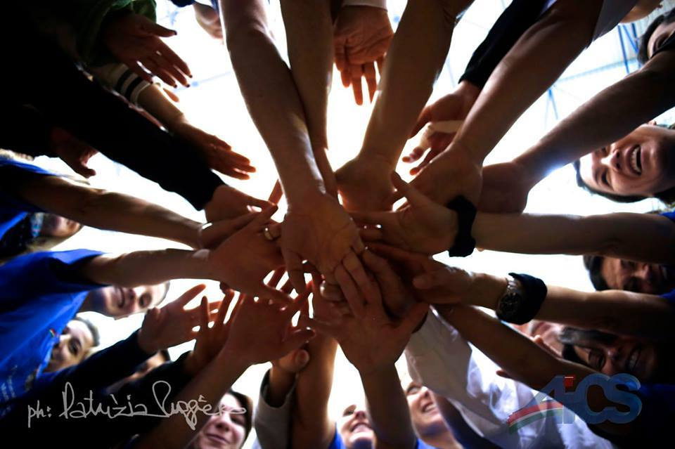
AICS MAMANET ITALIA
AICS officially inserts the Mamanet sport in its activities with an identification code also valid as an insurance

Slide 7
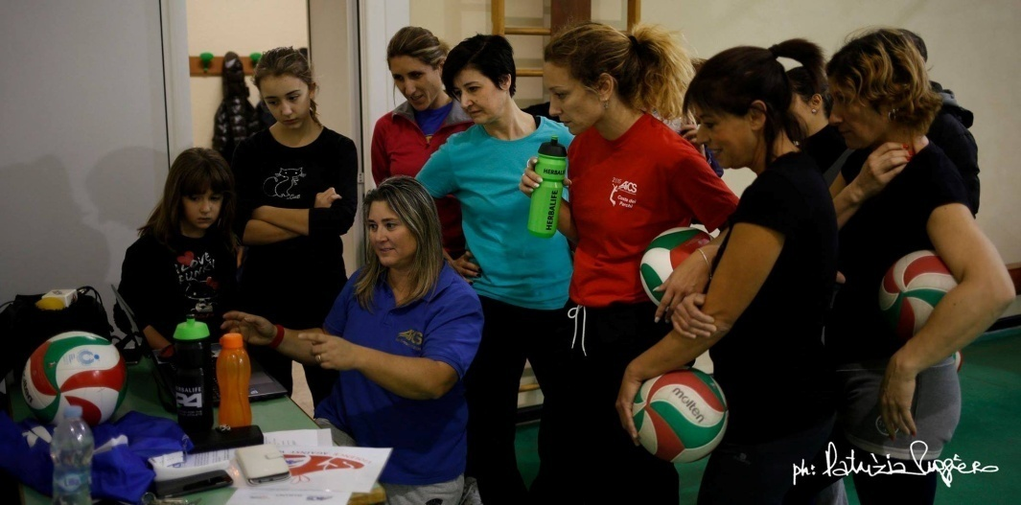
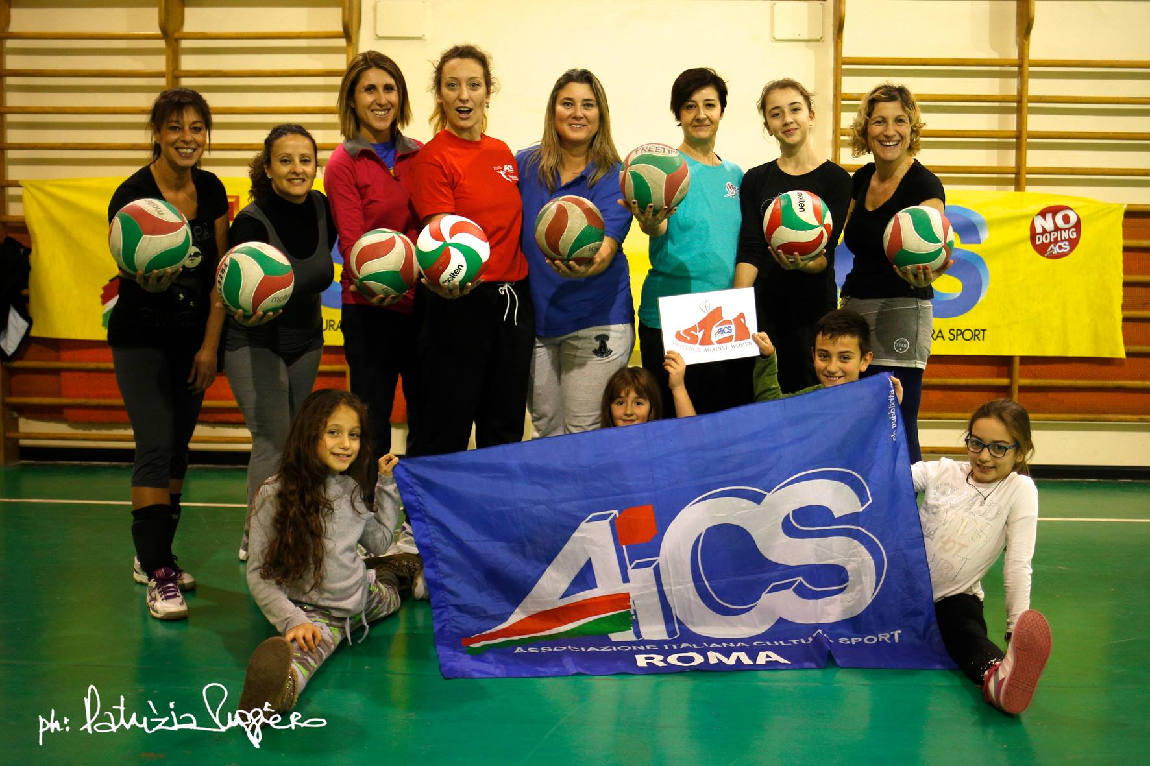
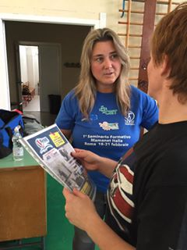
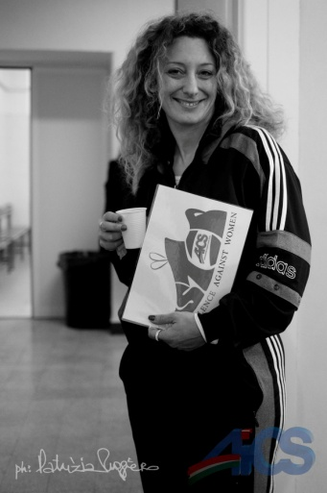
AICS MAMANET ITALIA
In February the first Italian official team is born:
AICS Mamanet Roma!

Slide 8
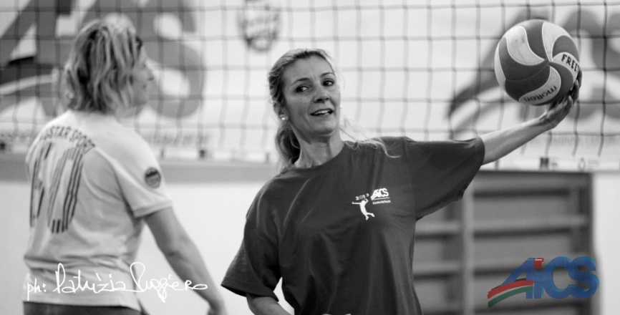
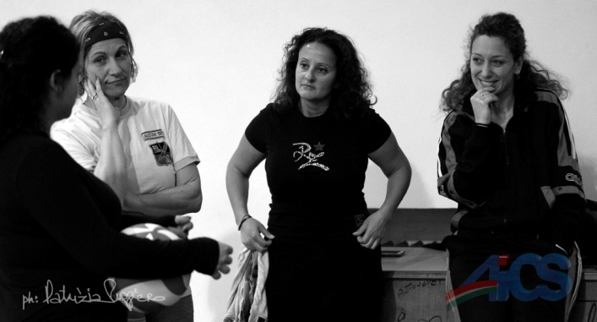
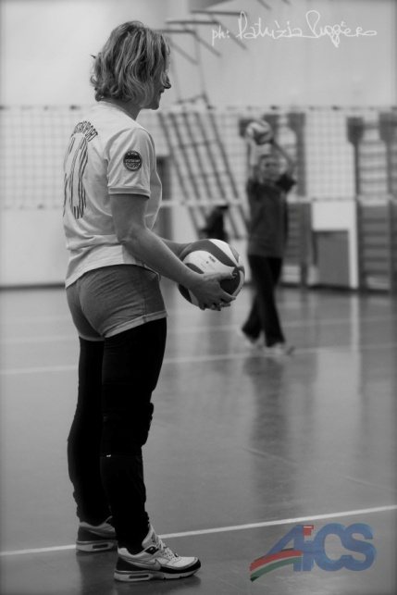
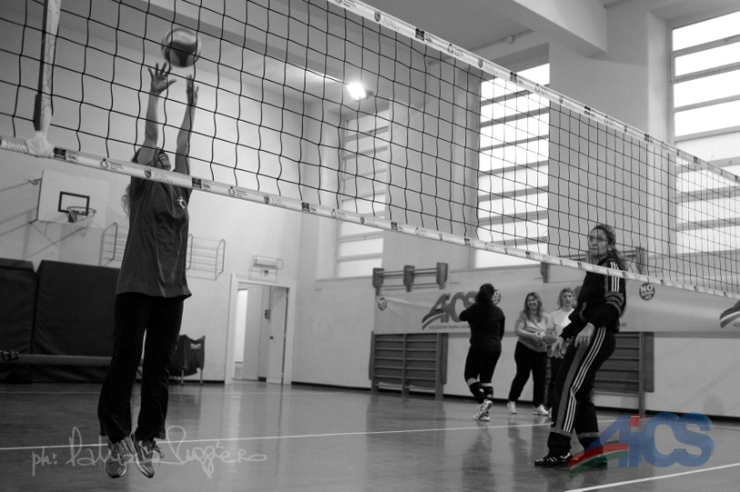
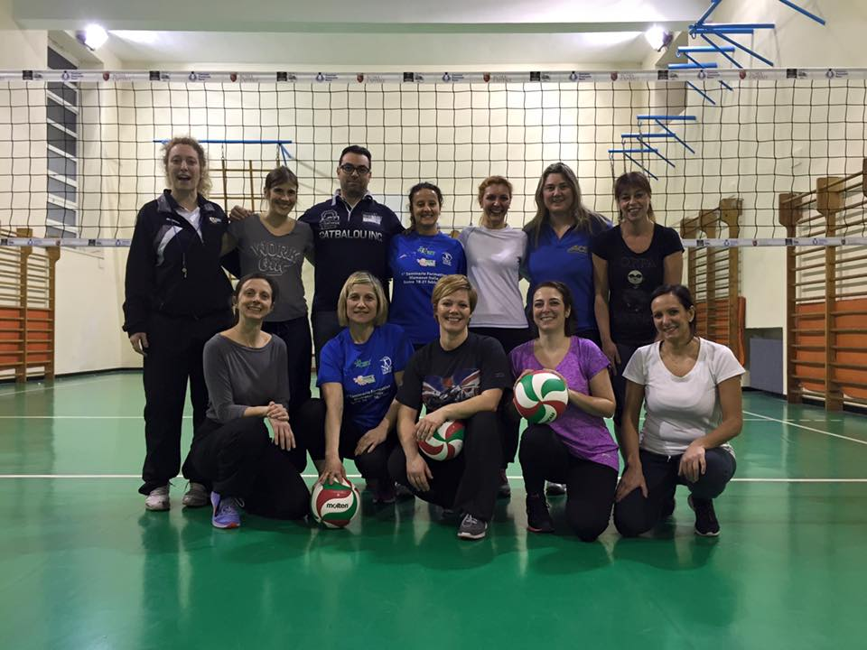
AICS MAMANET ITALIA
AICS Mamanet Roma

Slide 9
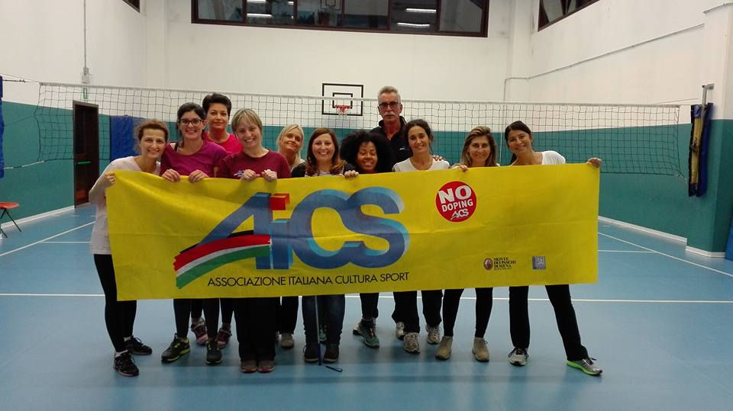
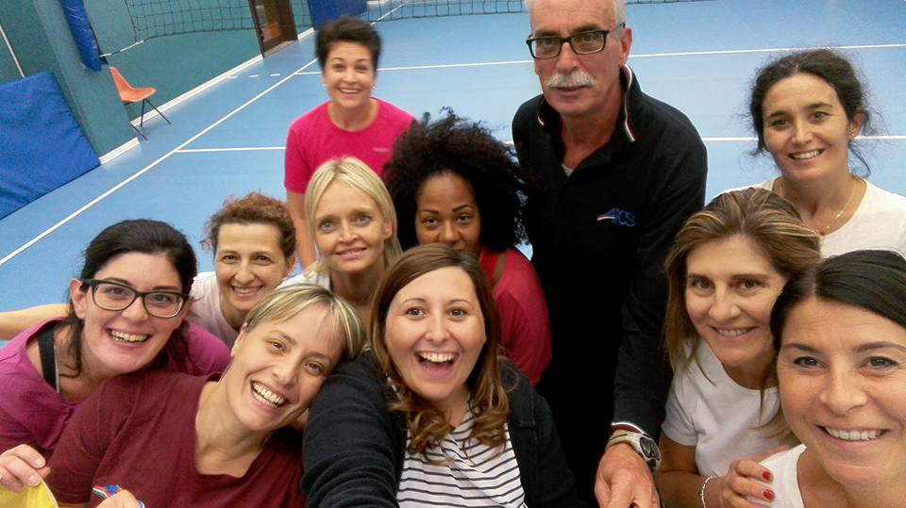
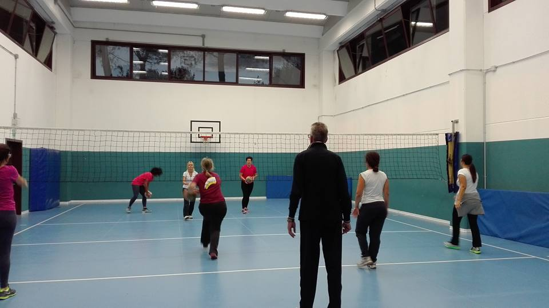
AICS MAMANET ITALIA
AICS MAMANET FORLI’

Slide 10
AICS MAMANET ITALIA
The official web site, the facebook page and Instagram profiles of Mamanet Italy

Slide 11
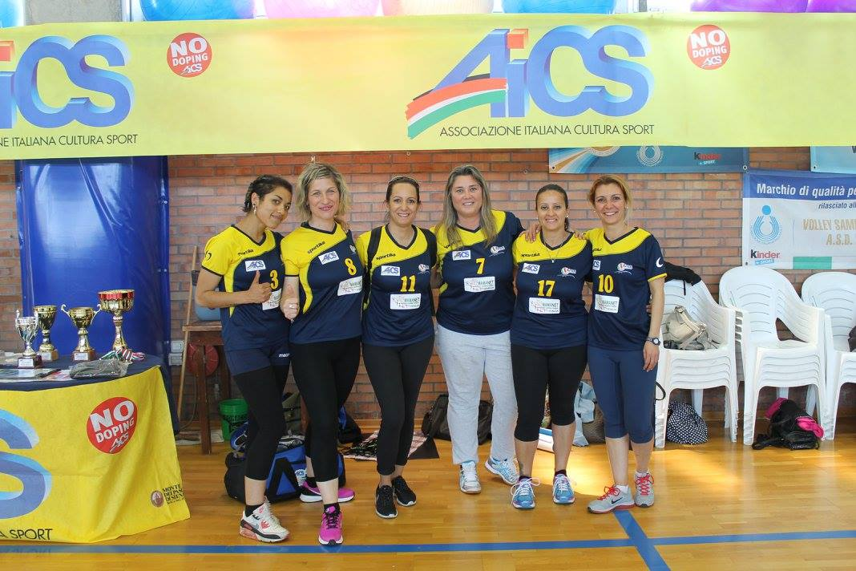
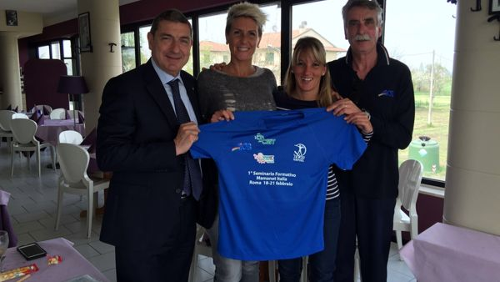
AICS MAMANET ITALIA
The Mamanet sport was inserted for the first time in the AICS National Sport event called SPORTINFIORE: from May 6 to 8 2016

Slide 12
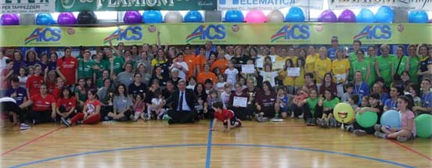
AICS MAMANET ITALIA
In May 7, the first AICS Mamanet Tournament City of Forlì takes place, with a huge success and more than 100 mothers involved!

Slide 13
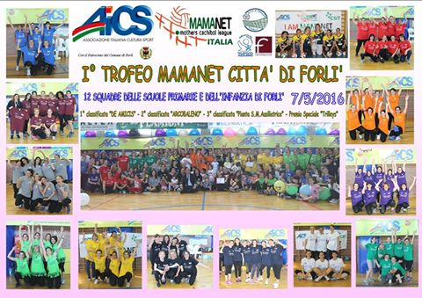
AICS MAMANET ITALIA

Slide 14
AICS MAMANET ITALIA
Facebook data after SPORTINFIORE and Forlì tournament
After only 4 days
Post viewed: 21.069
Interaction with the post: 23549
Interaction with the video: 4594
Photo: 420
Major audience: WOMEN

Slide 15
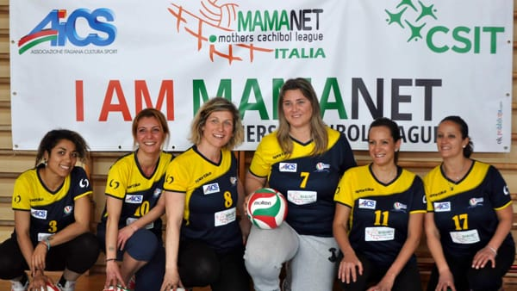
AICS MAMANET ITALIA
Most watched facebook post with 8278:
<Mamanet new sport from Israel>

Slide 16
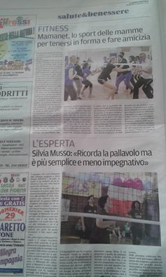
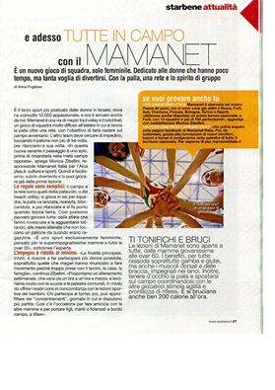
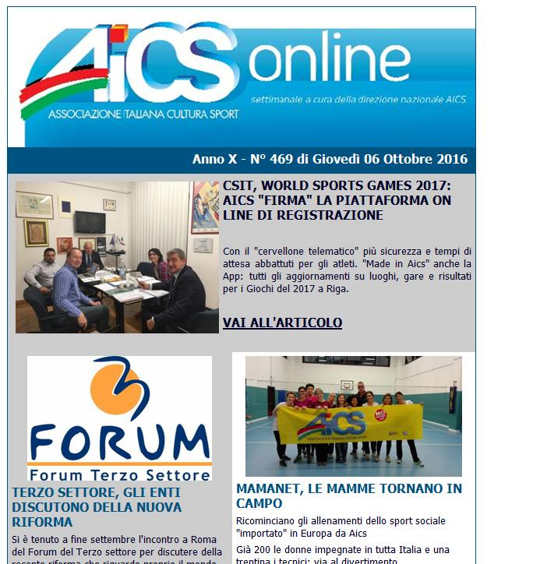
AICS MAMANET ITALIA
NEWSPAPER ARTICLES

Slide 17
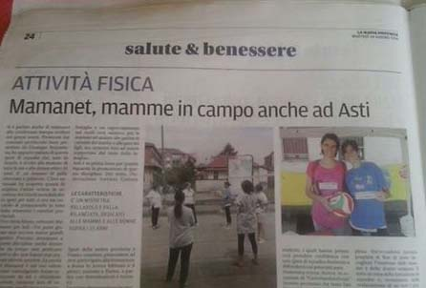
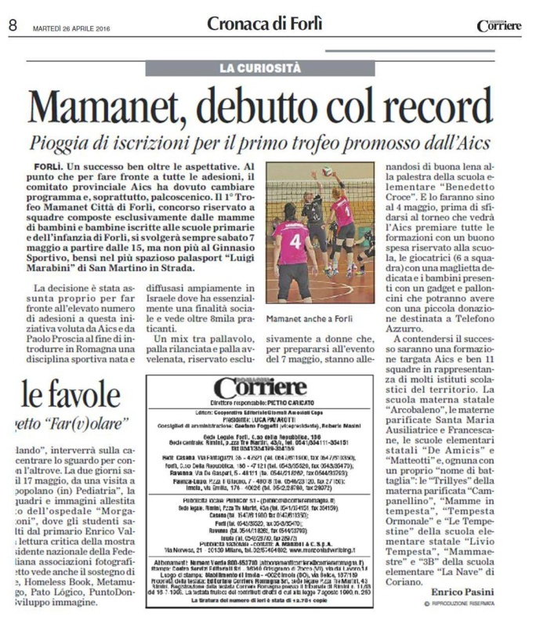
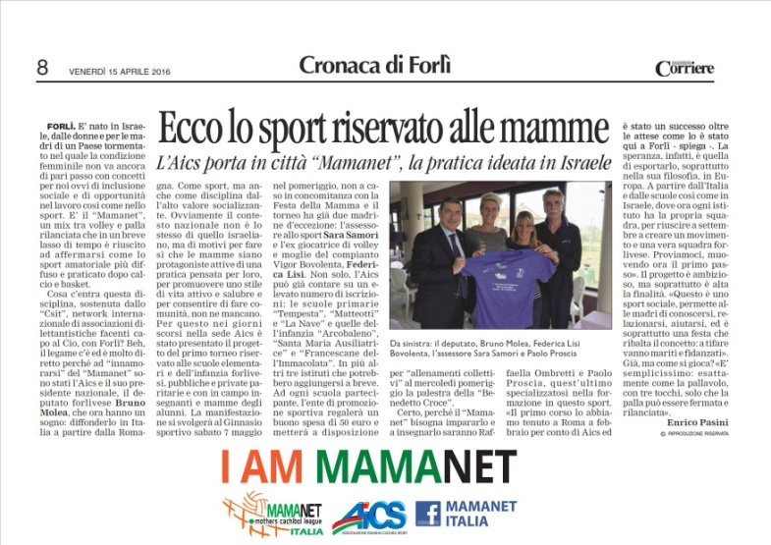
AICS MAMANET ITALIA
NEWSPAPER ARTICLES

Slide 18
AICS MAMANET ITALIA
Mamanet is promoted through the AICS system in the cities of:
Rome Cremona Florence Bologna Brescia | Forlì Asti Turin Naples Frosinone

Slide 19
AICS MAMANET ITALIA
The city of Cremona inserts Mamanet in a project againts bullying and violence in general

Slide 20
AICS MAMANET ITALIA
The city of Bologna inserts Mamanet in the book “Stop violence against women”, another national AICS project.

Slide 21
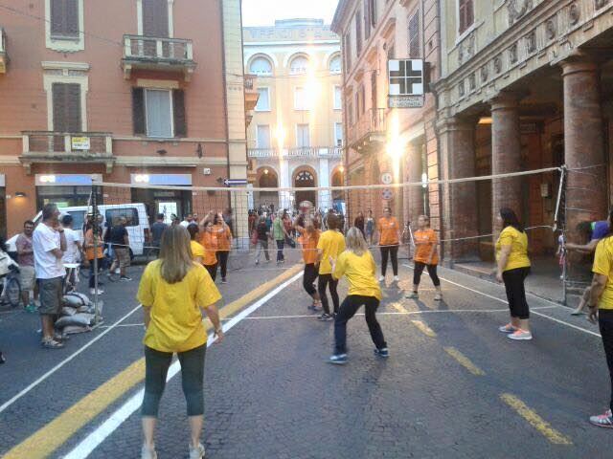
AICS MAMANET ITALIA
A new way to promote Mamanet
“THE STREET MAMANET”
FORLI’

Slide 22
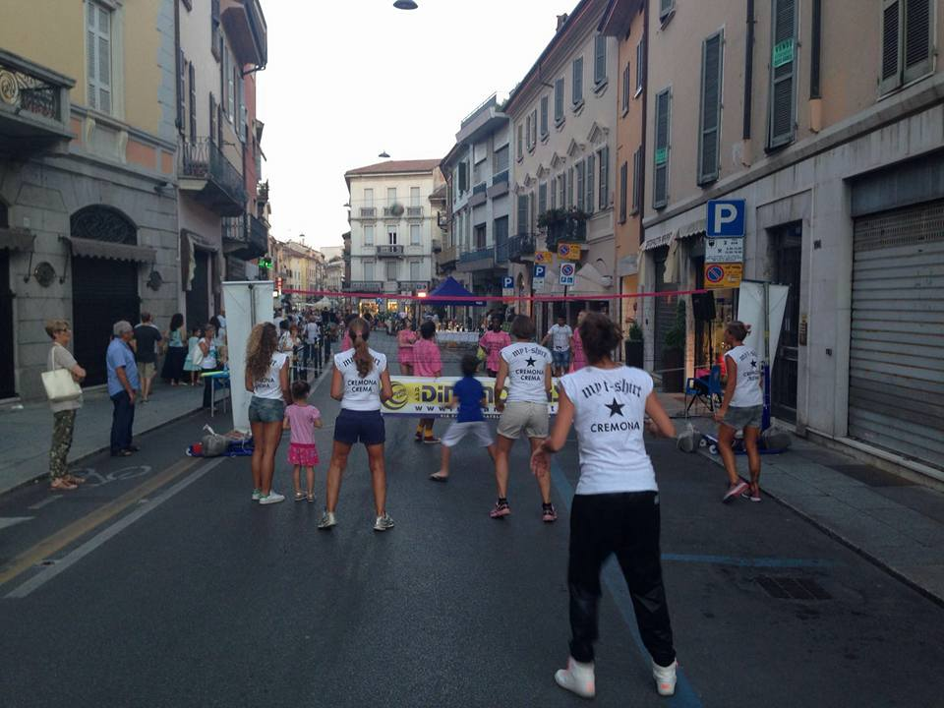
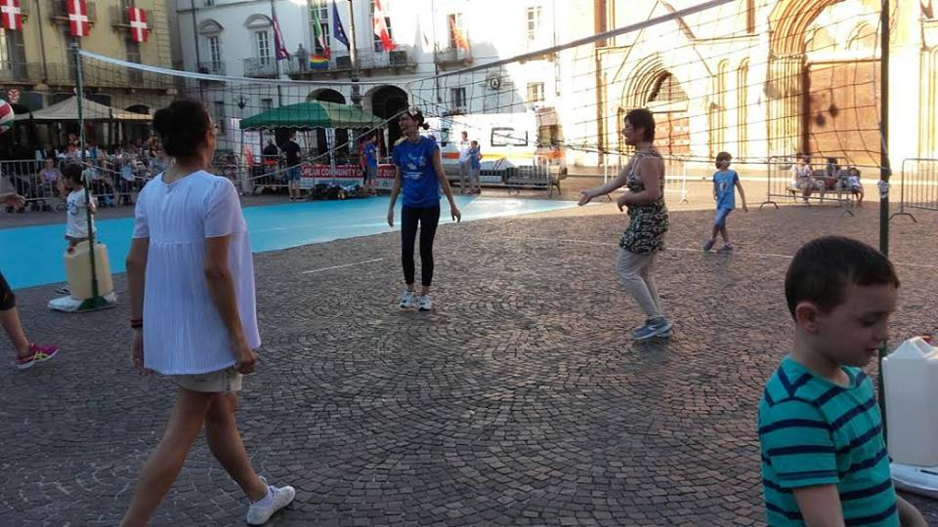
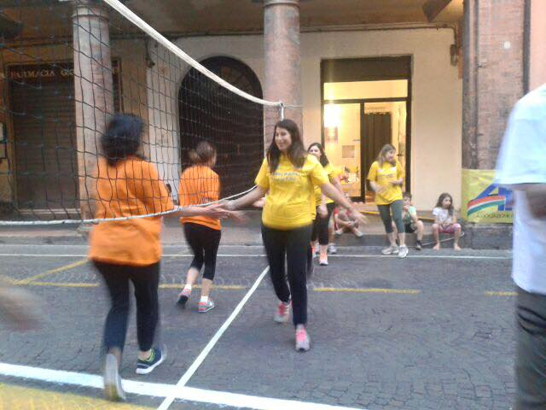
AICS MAMANET ITALIA
with the street mamanet you can play in the streets, squares, historic city centers
FORLI’
CREMONA
ASTI

Slide 23
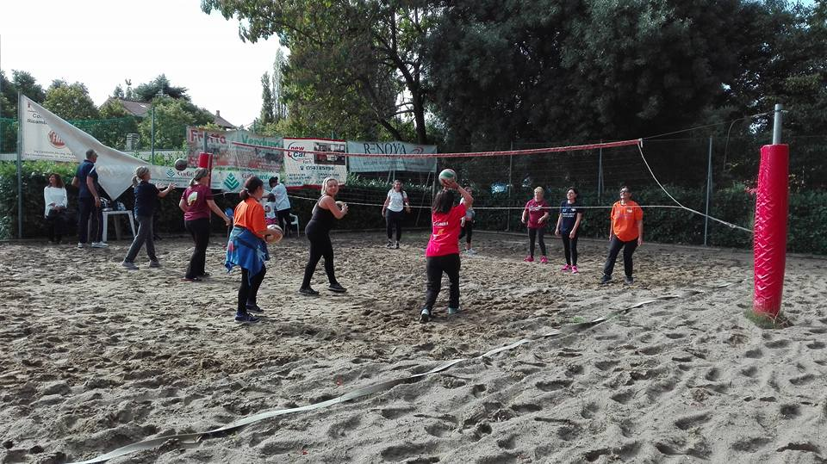
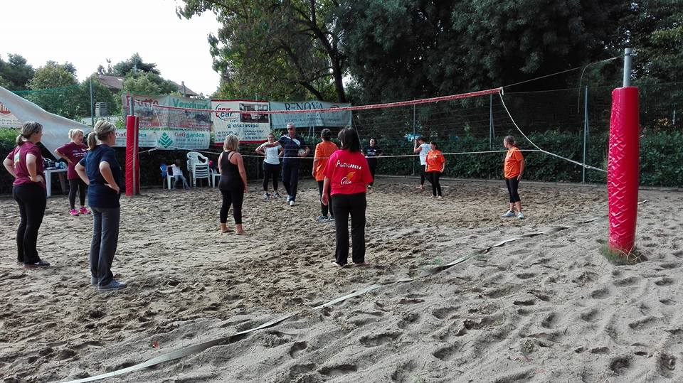
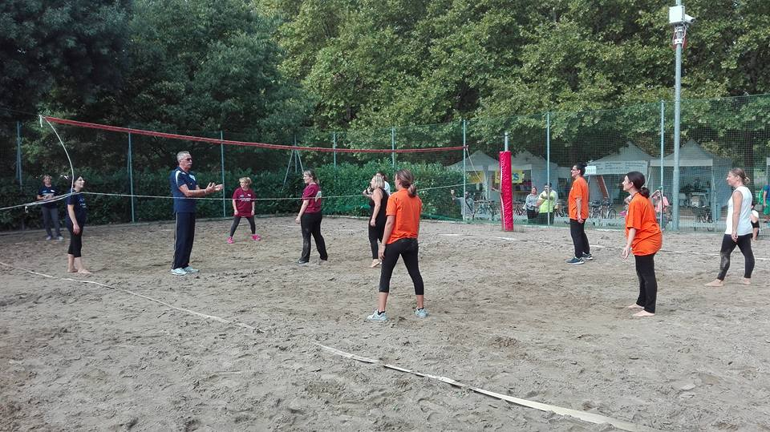
AICS MAMANET ITALIA
BEACH MAMANET

Slide 24
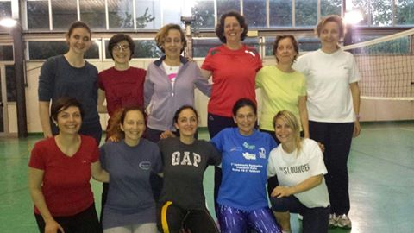
AICS MAMANET ITALIA
In May 19th the Mamanet event takes place in the University of the city of Asti
In May also the city of Florence begins to organize courses to learn Mamanet.

Slide 25
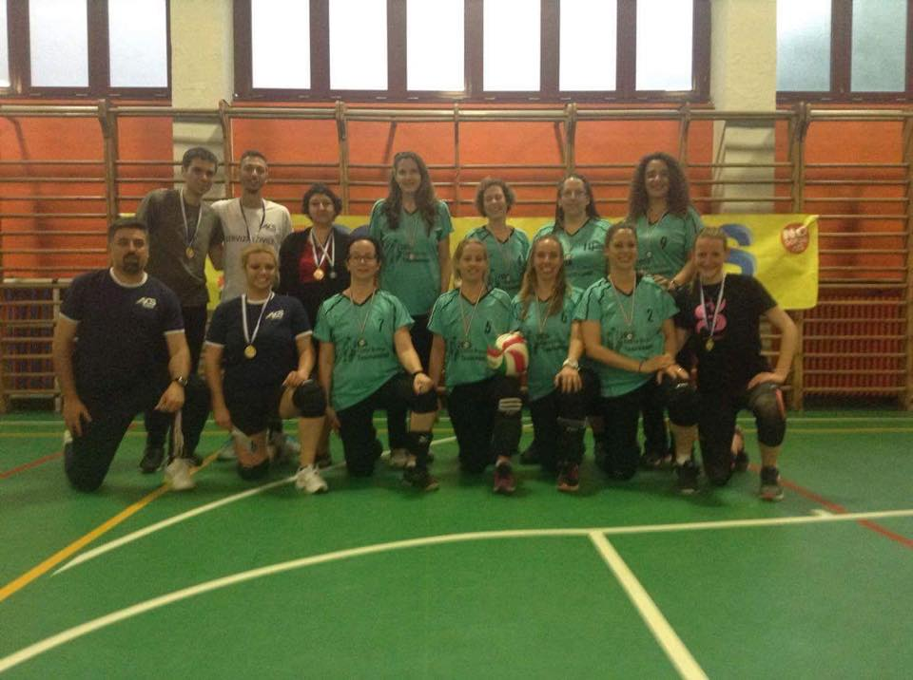
AICS MAMANET ITALIA
In May 20th, in Turin, an Israelian Mamanet team meets italian mothers, to introduce this sport in their city.

Slide 26
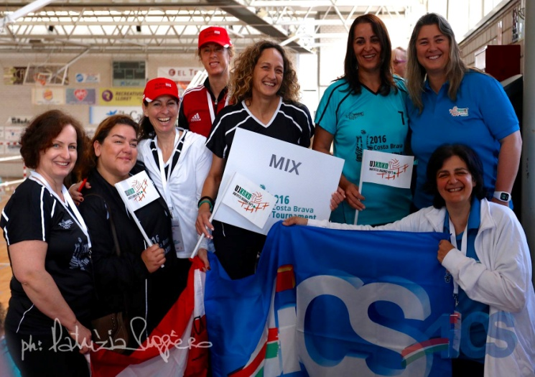
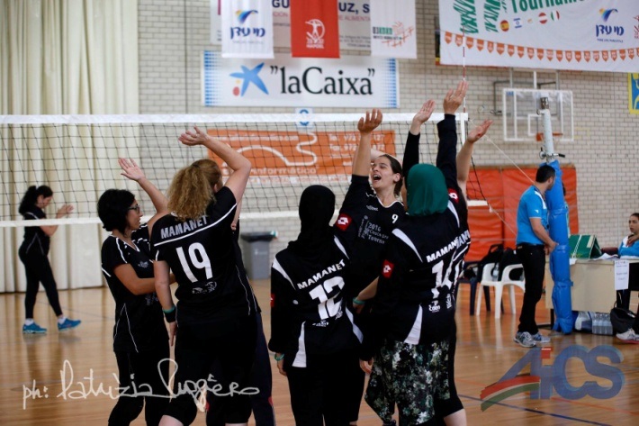
AICS MAMANET ITALIA
COSTA BRAVA SPAIN 2016
INTERNATIONAL TEAM

Slide 27
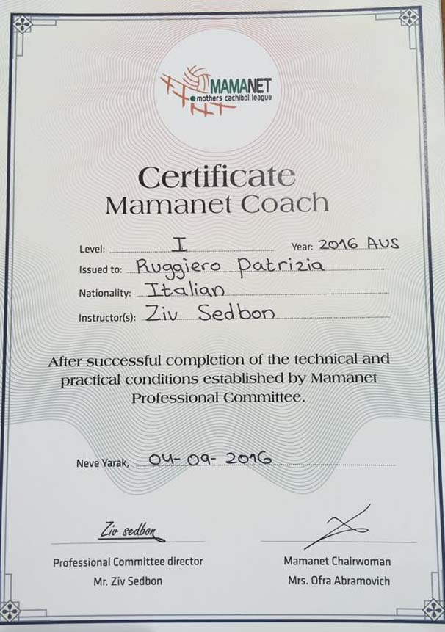
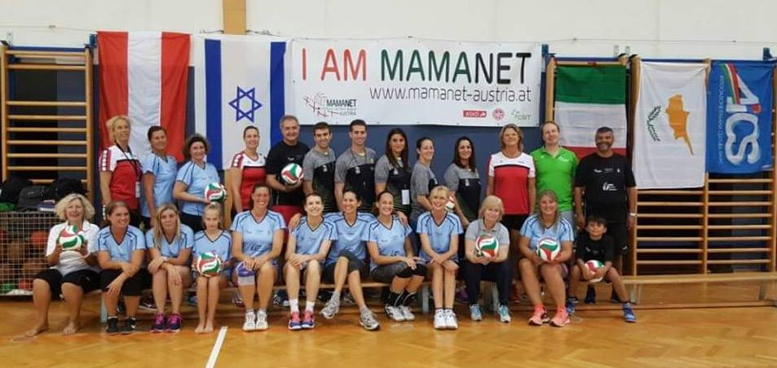
AICS MAMANET ITALIA
1° INTERNATIONAL
SEMINAR IN AUSTRIA

Slide 28
AICS MAMANET ITALIA
START MAMANET COURSES

Slide 29
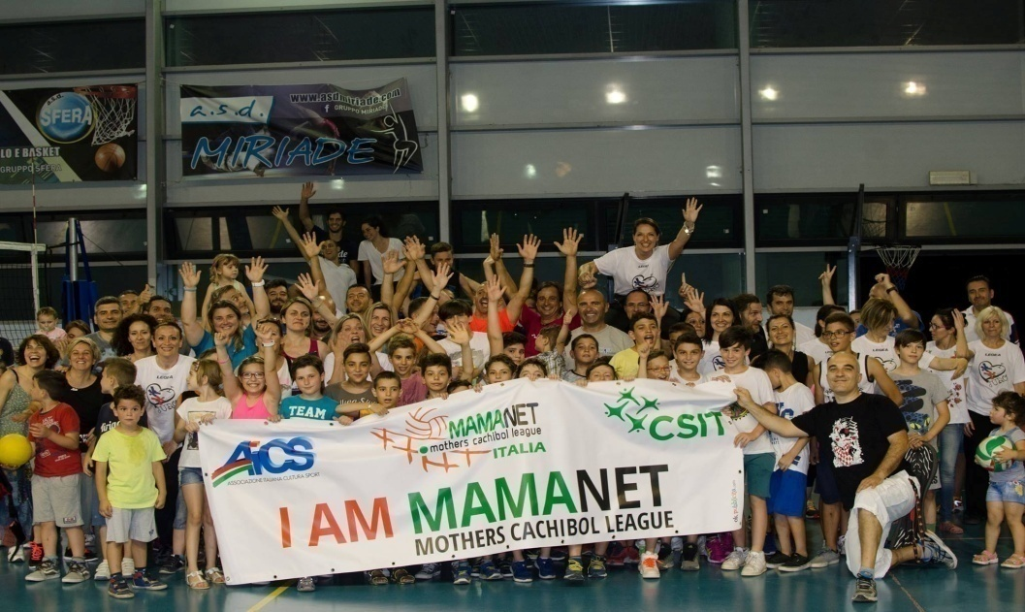
AICS MAMANET ITALIA
The dream continues with
EILAT 2016
WSG CSIT - RIGA 2017

